Slide 1
Monte Carlo 1st Assignment Report
Abhishek Agrahari
Roll No. = 190123066

Slide 2
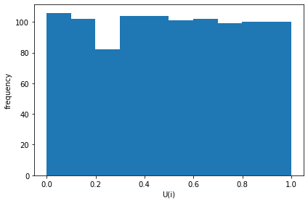
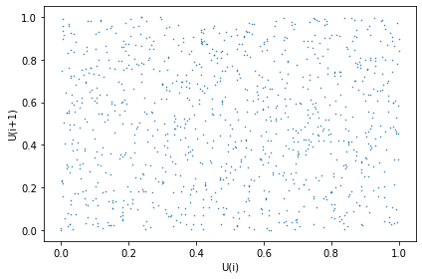
Question 1: N = 1000

Slide 3
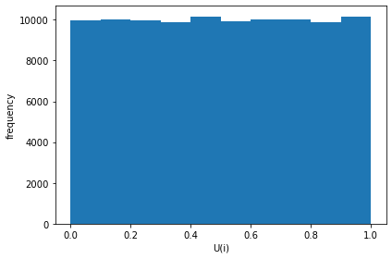
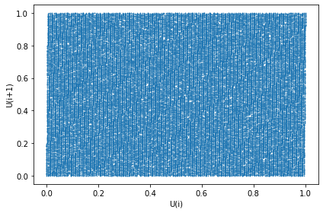
Question 1: N = 10000

Slide 4
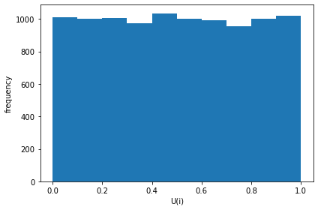
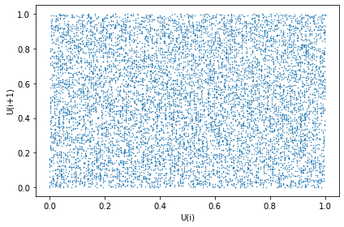
Question 1: N = 100000

Slide 5
Question 1: Observations
With increase in number of random values the scatter plot and histogram become uniform.

Slide 6
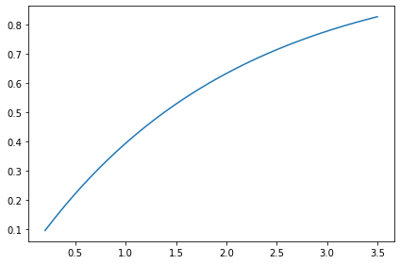
Question 2: Actual Distribution

Slide 7
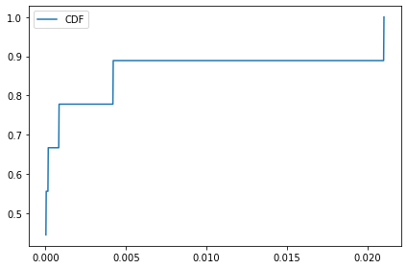
Question 2: Empirical Distribution N = 10

Slide 8
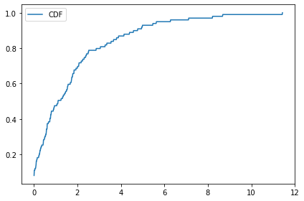
Question 2: Empirical Distribution N = 100

Slide 9
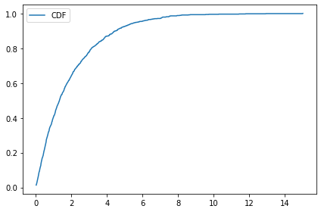
Question 2: Empirical Distribution N = 1000

Slide 10
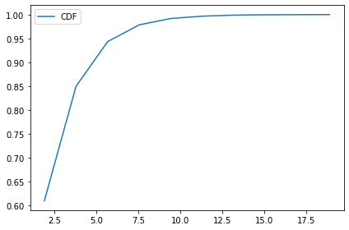
Question 2: Empirical Distribution N = 10000

Slide 11
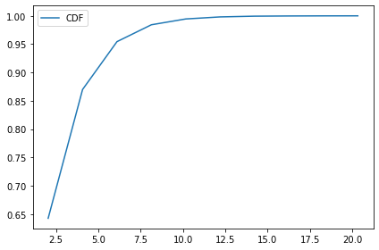
Question 2: Empirical Distribution N = 100000

Slide 12
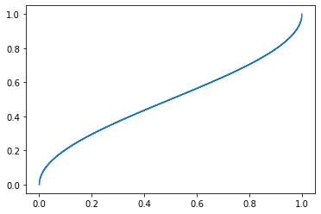
Question 3: Actual Distribution

Slide 13
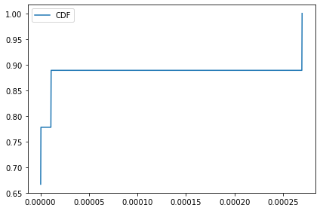
Question 3: Empirical Distribution N = 10

Slide 14
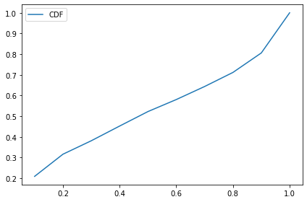
Question 3: Empirical Distribution N = 100

Slide 15
Question 3: Empirical Distribution N = 1000

Slide 16
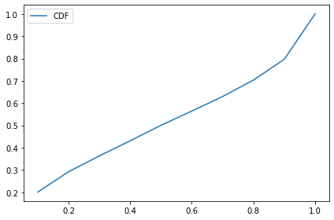
Question 3: Empirical Distribution N = 10000

Slide 17

Question 3: Empirical Distribution N = 100000

Slide 18
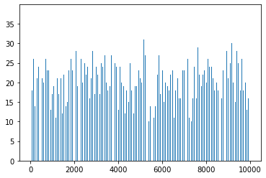
Question 4:

